Slide 1
Data Mining & Knowledge Discovery
IME 672
Lecture 7

Slide 2
Advanced Methods
Classification:

Slide 3
Naive Bayes Classifier: Comments
Advantages
Easy to implement
Good results obtained in most of the cases
Disadvantages
Assumption: class conditional independence, therefore loss of accuracy
Practically, dependencies exist among variables
E.g., Patients: Profile - age, family history, etc. Symptoms - fever, cough etc., Disease - lung cancer, diabetes, etc.
Dependencies among these cannot be modeled by Naïve Bayes Classifier

Slide 4
Bayesian Belief Networks
Unlike naive Bayesian classifiers, do not assume class conditional independence
Allow the representation of dependencies among subsets of attributes
Graphical model of causal relationships
Two components
a directed acyclic graph
set of conditional probability tables (CPT)
Node = random variable (discrete- or continuous)
Arc = probabilistic dependence

Slide 5
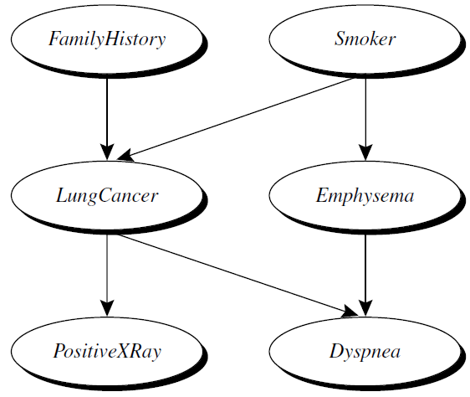
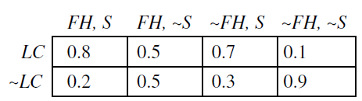
Bayesian Belief Networks
Arc Y -> Z implies Y is a parent, Z is a descendant

Slide 6
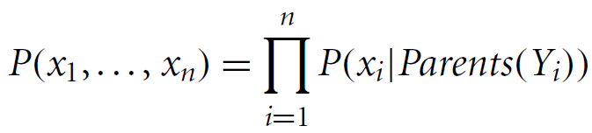
Bayesian Belief Networks
Each variable is conditionally independent of its non-descendants in the graph, given its parents
One CPT for each variable
X = (x₁,…, x_{n}) be a data tuple described by the variables or attributes Y₁,…, Y_{n}
Complete representation of the existing joint probability distribution

Slide 7
Bayesian Belief Networks
A node within the network can be selected as an “output” node, representing a class label attribute
May be more than one output node
Can return probability of each class
Various learning algorithms – gradient descent
Some applications
genetic linkage analysis
computer vision
document and text analysis
decision support systems
sensitivity analysis

Slide 8
Linear Regression

Slide 9
Linear Regression
Francis Galton introduced linear regression in 1877
Karl Pearson formalized the algebra
Statisticians say … | Data Miners say … | Meaning …
Independent Variables | Predictor Variables | Things you can use as inputs to predict an outcome
Dependent Variable | Target Variable | The outcome you want to predict with the inputs

Slide 10
Single Predictor Problem
Predict volume of egg sales in a supermarket
Target variable: number of cases of eggs sold each week
Predictor variable: weekly egg prices
Two years of historical data available
Eggs data set from the BCA data library in R

Slide 11
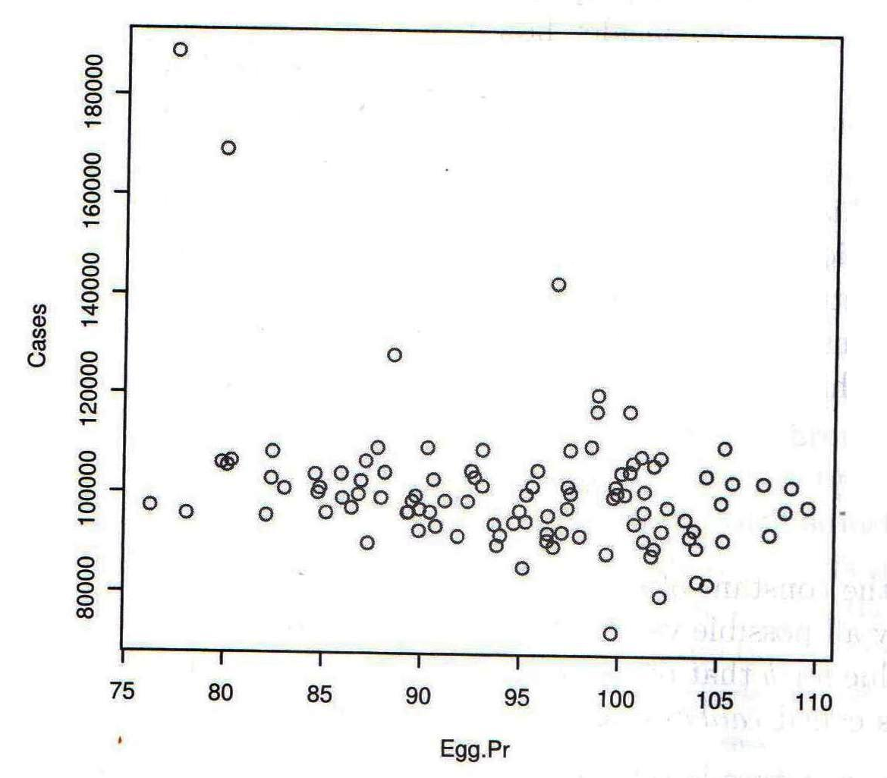
Single Predictor Problem
Weekly Eggs Sales and Prices in Southern California

Slide 12
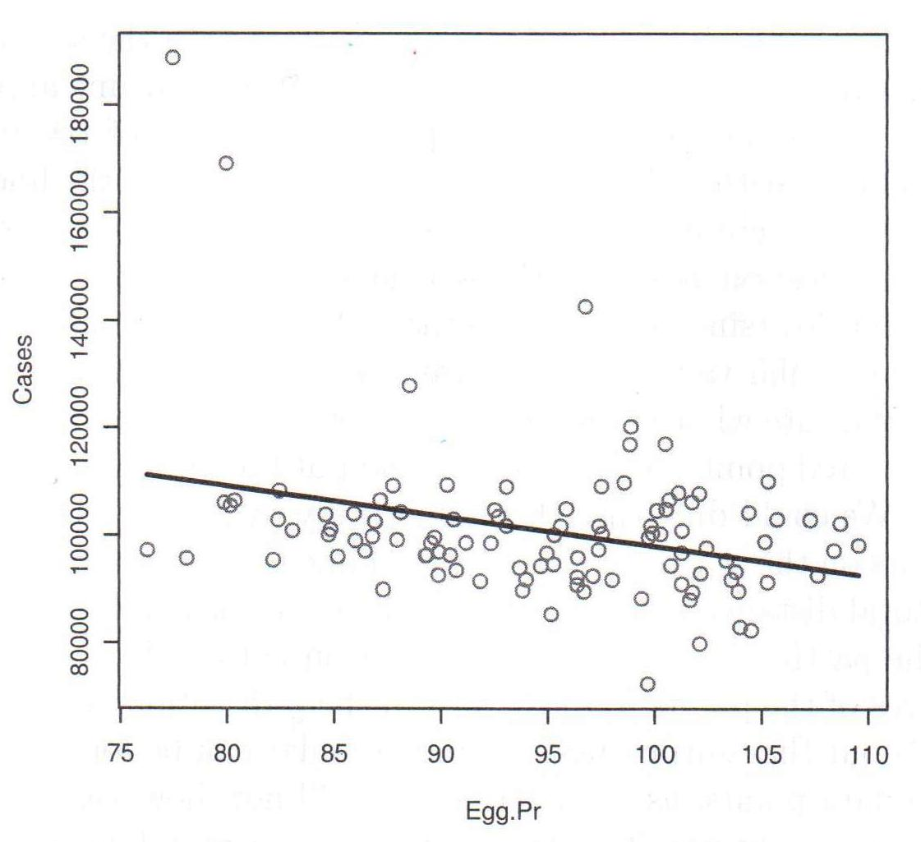
Single Predictor Problem
Regression Line and Scatter Plot

Slide 13
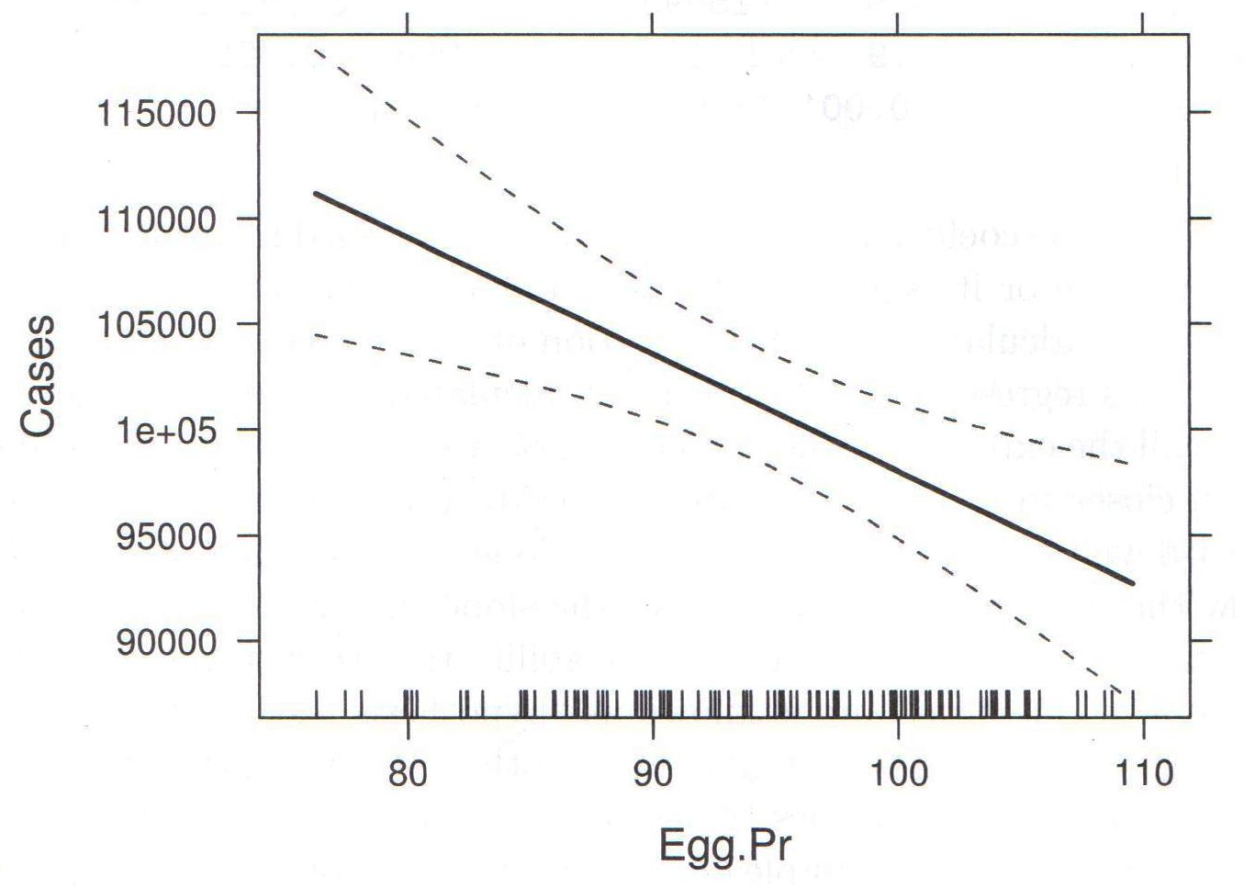
Single Predictor Problem
95% Confidence Limits of the Regression Prediction

Slide 14
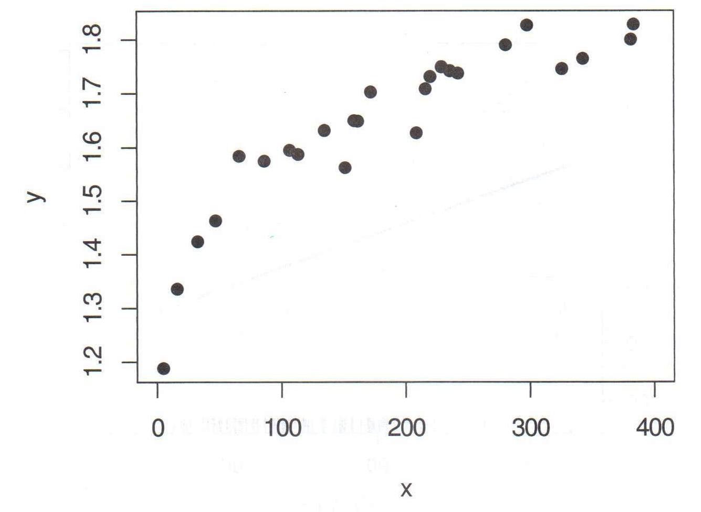
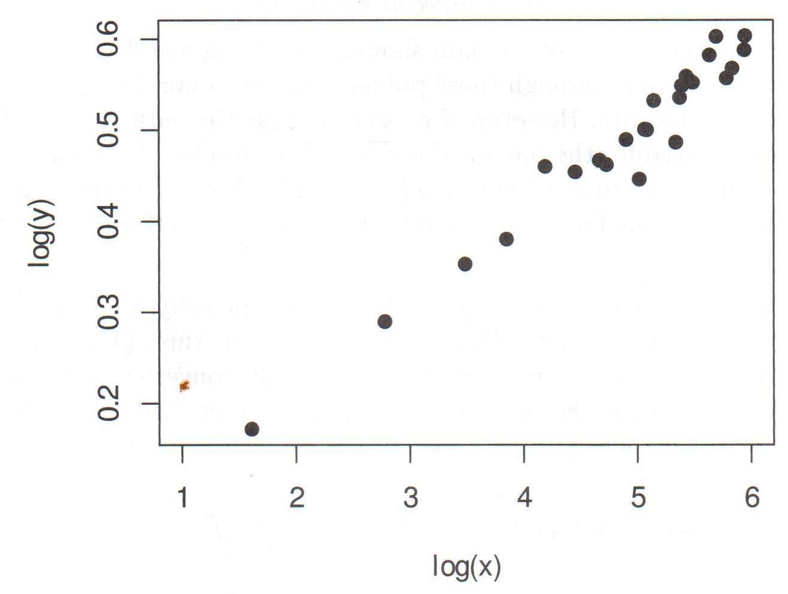
Non-linear Relationships

Slide 15
Neural Networks

Slide 16
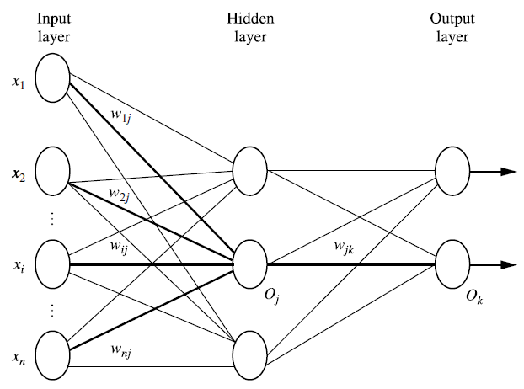
Neural Networks
An information processing system inspired by biological nervous systems
A set of connected input/output units in which each connection has a weight associated with it

Slide 17
Neural Networks
The network learns by adjusting the weights so as to be able to predict the correct class label of the input tuples
Statistically: nonlinear regression
Multilayer feed-forward networks: given enough hidden units and enough training samples, can closely approximate any function
Disadvantages
long training times
require a number of parameters
poor interpretability

Slide 18
Neural Networks
Advantages
High tolerance of noisy data
Ability to classify untrained patterns
Require little knowledge of relationships between attributes and classes
Well suited for continuous-valued inputs and outputs
Inherently parallel: parallelization techniques can be used to speed up computation
Techniques recently developed for rule extraction from trained neural networks

Slide 19
Backpropagation Algorithm
Initialize the weights
weights and bias (thresholds) in the network are initialized to small random numbers (e.g.,[-1.0,1.0], [-0.5 to 0.5])
Propagate the inputs forward
training tuple is fed to the network’s input layer
inputs pass through the input units unchanged
net input to a unit in the hidden or output layers is computed as a linear combination of its inputs

Slide 20
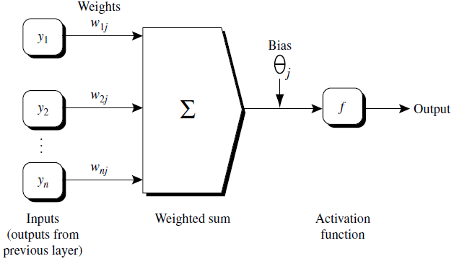


Backpropagation Algorithm
Each unit in the hidden and output layers takes its net input and then applies an activation function to it
Logistic / sigmoid function is used
The logistic function is nonlinear and differentiable, allowing the backpropagation algorithm to model classification problems that are linearly inseparable

Slide 21


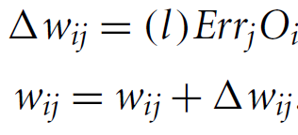
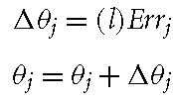
Backpropagation Algorithm
Backpropagate the error
Error is propagated backward by updating the weights and biases to reflect the error of the network’s prediction
Error Err_{j} of a unit in output layer is computed by
Error of a hidden layer unit j is
Weights and biases are updated as ( l being learning rate)

Slide 22
Backpropagation Algorithm
Terminating condition
Training stops when
All in the previous epoch (iteration) are below some specified threshold, or
The percentage of tuples misclassified in the previous epoch is below some specified threshold, or
A prespecified number of epochs has expired

Slide 23
Backpropagation Algorithm
Neural network learning for classification or numeric prediction, using the backpropagation algorithm
Input
D, a data set consisting of the training tuples and their associated target values;
l, the learning rate;
network, a multilayer feed-forward network
Output: A trained neural network

Slide 24
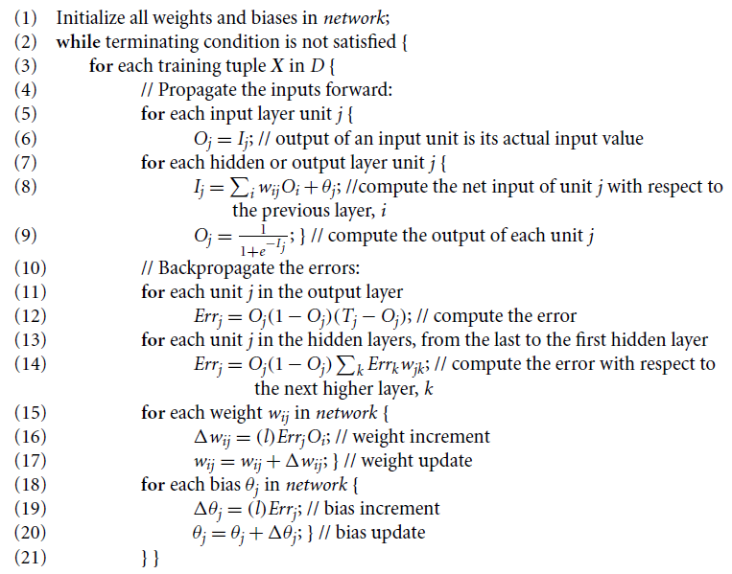

Slide 25
Backpropagation Algorithm
Some comments
Backpropagation learns using a gradient descent method
Minimize mean squared distance between the network’s class prediction and the known target value
Learning rate helps avoid getting stuck at a local minimum
If learning rate is too small, learning occurs at a very slow pace
If learning rate is too large, oscillation between inadequate solutions may occur
Given |D| tuples and w weights, each epoch requires O(|D|*w) time

Slide 26
Support Vector Machines

Slide 27
Support Vector Machines
A relatively new classification method for both linear and nonlinear data – (Vladimir Vapnik, 1992)
Uses a nonlinear mapping to transform the original training data into a higher dimension
With the new dimension, it searches for the linear optimal separating hyperplane
With an appropriate nonlinear mapping to a sufficiently high dimension, data from two classes can always be separated by a hyperplane
SVM finds this hyperplane using support vectors (“essential” training tuples) and margins (defined by the support vectors)

Slide 28
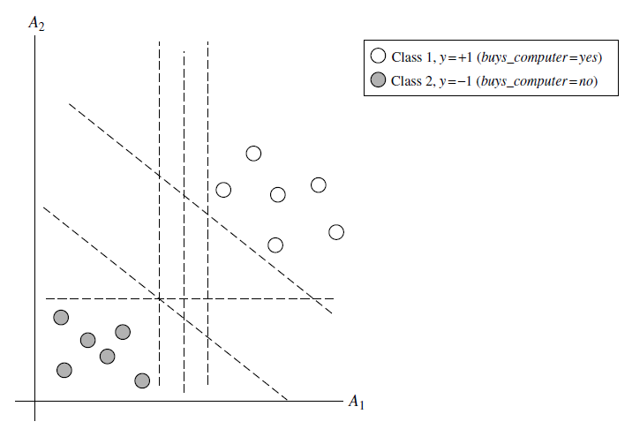
Support Vector Machines

Slide 29
Support Vector Machines
There are an infinite number of separating hyperplanes
Objective is to find the “best” hyperplane that will have the minimum classification error on unseen tuples
Maximum marginal hyperplane

Slide 30
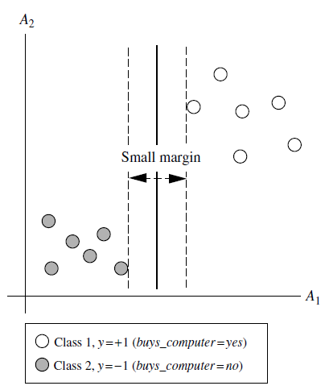
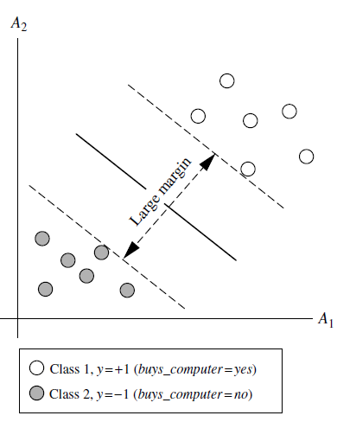
Support Vector Machines

Slide 31
Support Vector Machines
A separating hyperplane can be written as
W ● X + b = 0
where W={w₁, w₂, …, w_{n}} is a weight vector and b a scalar (bias)
For 2-D it can be written as
w₀ + w₁ x₁ + w₂ x₂ = 0
The hyperplane defining the sides of the margin:
H₁: w₀ + w₁ x₁ + w₂ x₂ ≥ 1 for y_{i} = +1,
H₂: w₀ + w₁ x₁ + w₂ x₂ ≤ – 1 for y_{i} = –1
Any training tuples that fall on hyperplanes H₁ or H₂ (i.e., the sides defining the margin) are support vectors
Constrained (convex) quadratic optimization problem: Quadratic objective function and linear constraints

Slide 32
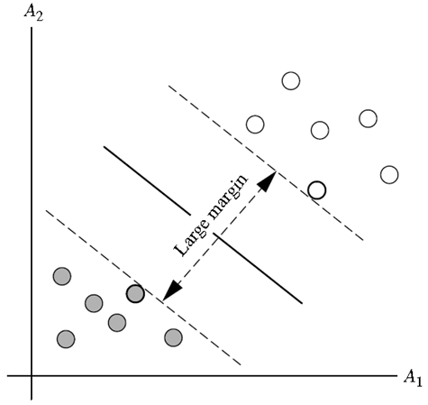
Support Vector Machines
Maximum separating hyperplane = maximum distance between the nearest training tuples
The support vectors are shown with red thick border

Slide 33
SVM and High Dimensional Data
Complexity of trained classifier is characterized by the # of support vectors rather than the dimensionality of the data
Support vectors: the essential or critical training examples, lie closest to the decision boundary (MMH)
If all training examples are removed except the support vectors and the training is repeated, the same separating hyperplane would be found
The number of support vectors found can be used to compute an (upper) bound on the expected error rate of the SVM classifier, which is independent of the data dimensionality
SVM with a small number of support vectors can have good generalization, even when the dimensionality of the data is high

Slide 34
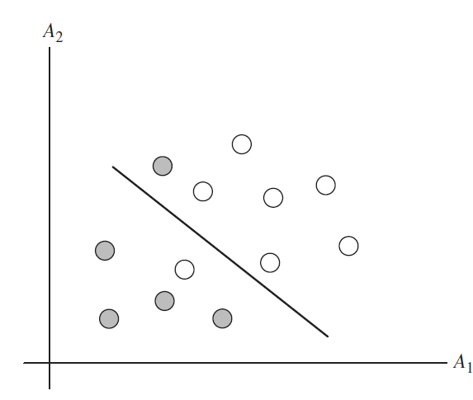
SVM—Linearly Inseparable
Transform the original input data into a higher dimensional space using a nonlinear mapping
Search for a linear separating hyperplane in the new space
MMH found in the new space corresponds to a nonlinear separating hypersurface in the original space

Slide 35
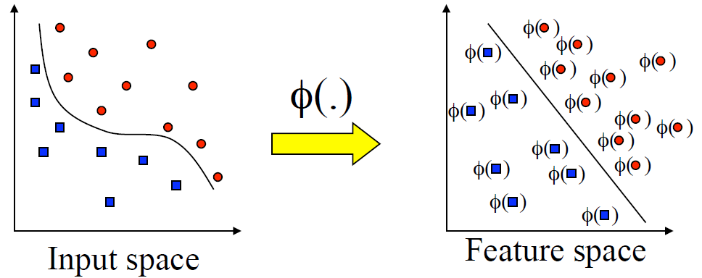
SVM—Linearly Inseparable

Slide 36
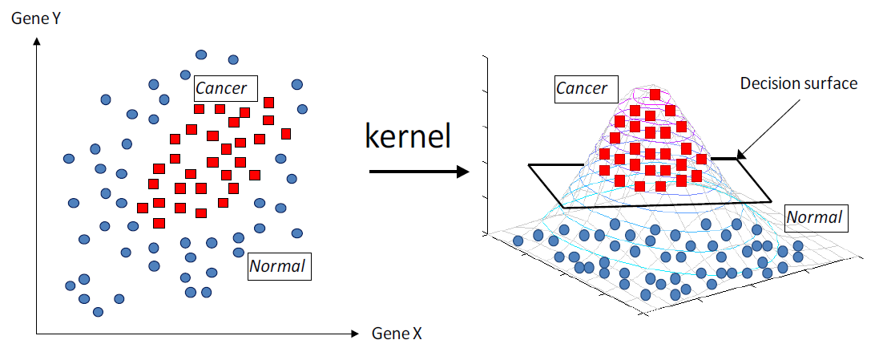
SVM—Linearly Inseparable
Hyperplane

Slide 37
SVM Related Links
SVM Website: http://www.kernel-machines.org/
Representative implementations
LIBSVM: an efficient implementation of SVM, multi-class classifications, nu-SVM, one-class SVM, including also various interfaces with java, python, etc.
SVM-light: simpler but performance is not better than LIBSVM, support only binary classification and only in C
SVM-torch: another recent implementation also written in C

Slide 38
Other Classification Methods

Slide 39
Genetic Algorithms (GA)
Genetic Algorithm: based on an analogy to biological evolution
An initial population is created consisting of randomly generated rules
Each rule is represented by a string of bits
E.g., if A₁ and ¬A₂ then C₂ can be encoded as 100
If an attribute has k > 2 values, k bits can be used
Based on the notion of survival of the fittest, a new population is formed to consist of the fittest rules and their offspring
The fitness of a rule is represented by its classification accuracy on a set of training examples
Offspring are generated by crossover and mutation
The process continues until a population P evolves when each rule in P satisfies a prespecified threshold
Slow but easily parallelizable

Slide 40
Fuzzy Set Approach
Fuzzy set approaches replace “brittle” threshold cutoffs for continuous-valued attributes with membership degree functions
Discretize attributes into categories (e.g., {low_income, medium_income,high_income})
Assign a fuzzy membership value to each of the discrete categories (e.g. $49K belongs to “medium_income” with fuzzy value 0.15 but belongs to “high_income” with fuzzy value 0.96)

Slide 41
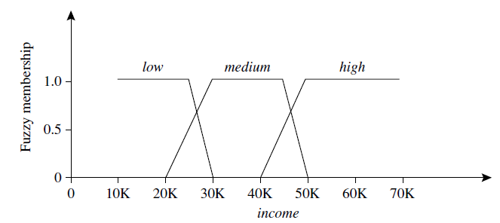
Fuzzy Set Approach
Works at a high abstraction level and offers a means for dealing with imprecise data
Fuzzy membership values do not have to sum to 1

Slide 42
Rough Set (RS) Approach
Used for classification to discover structural relationships within imprecise or noisy data
Applies to discrete-valued attributes
RS theory is based on the establishment of equivalence classes within the given training data
All the data tuples forming an equivalence class are identical w.r.t. the attributes describing the data
Given real-world data, it is common that some classes cannot be distinguished in terms of the available attributes

Slide 43
Rough Set Approach
A RS for a given class C is approximated by two sets: a lower approximation (certain to be in C) and an upper approximation (cannot be described as not belonging to C)
RS can also be used for
attribute subset selection (or feature reduction, where attributes that do not contribute to the classification of the given training data can be identified and removed)
relevance analysis (where the contribution or significance of each attribute is assessed with respect to the classification task)

Slide 44
Rule-Based Classification

Slide 45
Using IF-THEN Rules for Classification
Represent the knowledge in the form of IF-THEN rules
R: IF age = youth AND student = yes THEN buys_computer = yes
Can be generated either from a decision Tree or directly from the training data using a sequential covering algorithm
The “IF” part (or left side) of a rule is known as the rule antecedent or precondition
The “THEN” part (or right side) is the rule consequent
If the rule antecedent holds true for a given tuple, we say that the rule is satisfied and that the rule covers the tuple
Assessment of a rule R: coverage and accuracy
n_{covers} = # of tuples covered by R
n_{correct} = # of tuples correctly classified by R

Slide 46
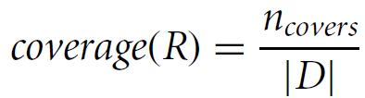
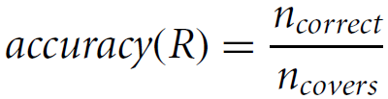
Using IF-THEN Rules for Classification
If more than one rule is triggered, need conflict resolution
Size ordering: assigns highest priority to the triggering rules that has the “toughest” requirement (i.e., with the most attribute tests)
Rule ordering: rules prioritized beforehand
class-based, rule-based

Slide 47
Using IF-THEN Rules for Classification
Class-based ordering: classes are sorted in decreasing order of prevalence or misclassification cost per class
Rule-based ordering (decision list): rules are organized into one long priority list, according to some measure of rule quality or by experts
What if no rule satisfied by X?
Set up a default rule to specify a default class, based on a training set
May be the class in majority or the majority class of the tuples that were not covered by any rule

Slide 48
Rule Extraction from a Decision Tree
Rules are easier to understand than large trees
One rule is created for each path from the root to a leaf
Each splitting criterion along a given path is logically ANDed to form the rule antecedent (“IF” part)
The leaf node holds the class prediction, forming the rule consequent (“THEN” part)

Slide 49
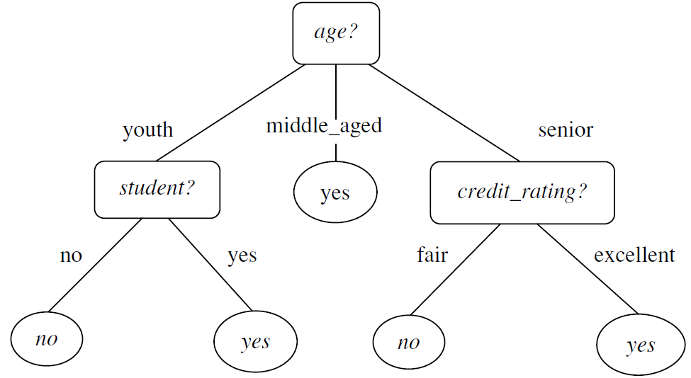
Rule Extraction from a Decision Tree
Example
IF age = youth AND student = no THEN buys_computer = no
IF age = youth AND student = yes THEN buys_computer = yes
IF age = mid-age THEN buys_computer = yes
IF age = senior AND credit_rating = fair THEN buys_computer = no
IF age = senior AND credit_rating = excellent THEN buys_computer = yes

Slide 50
Rule Extraction from a Decision Tree
Rules extracted are mutually exclusive and exhaustive
Mutually exclusive: cannot have rule conflicts here as no two rules will be triggered for the same tuple
Exhaustive: one rule for each possible attribute–value combination
Since one rule extracted per leaf, the set of rules is not much simpler than the corresponding decision tree
Rule pruning required

Slide 51
Rule Induction: Sequential Covering Algorithm
Extracts rules directly from training data
Typical sequential covering algorithms: FOIL, AQ, CN2, RIPPER
Rules are learned sequentially, each rule for a given class C_{i} will cover many tuples of C_{i} but none (or few) of the tuples of other classes
Steps:
Rules are learned one at a time
Each time a rule is learned, the tuples covered by the rules are removed
Repeat the process on the remaining tuples until termination condition, e.g., when no more training examples or when the quality of a rule returned is below a user-specified threshold

Slide 52
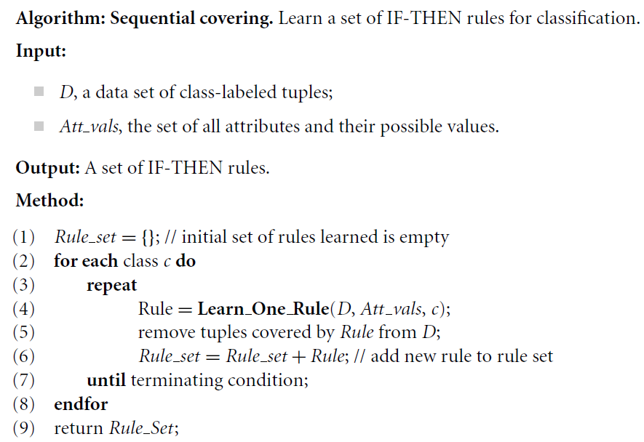
Basic Sequential Covering Algorithm

Slide 53
How are rules learned?
Start with the most general rule possible:
IF THEN loan_decision = accept
Add new attributes by adopting a greedy depth-first strategy
Pick the one that improves the rule quality most
The resulting rule should cover relatively more of the “accept” tuples

Slide 54
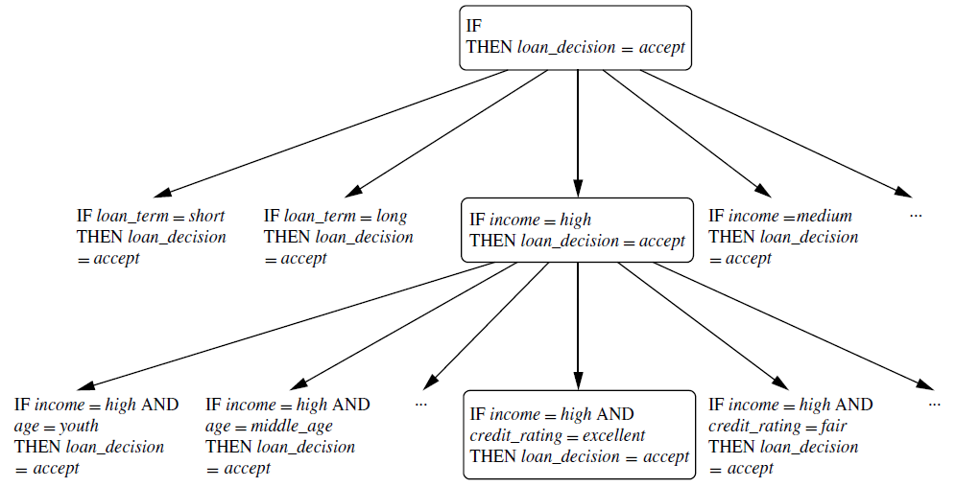
Rule Learning

Slide 55
Rule-Quality measures
Need to consider both coverage and accuracy
Entropy - prefers rules that cover a large number of tuples of a single class and few tuples of other classes
Tuples of the class for which rules are learned are called positive tuples, while the remaining tuples are negative
Foil-gain (in FOIL & RIPPER): assesses information gained by extending the antecedent
Favors rules that have high accuracy and cover many positive tuples

Slide 56
Rule Pruning
Prune a rule, R, if the pruned version of R has greater quality, as assessed on an independent set of tuples
If FOIL_Prune is higher for the pruned version of R, prune R

Slide 57
Summary
Classification methods
Decision tree induction
Naive Bayesian classifier
Bayesian Belief networks
Backpropagation (Neural networks)
Support Vector Machine
Genetic algorithms
Rough set approach
Fuzzy set approach
Rule based classification

Slide 58
Classifier Evaluation Metrics
Confusion Matrix:
Actual class\Predicted class | C₁ | ¬ C₁
C₁ | True Positives (TP) | False Negatives (FN)
¬ C₁ | False Positives (FP) | True Negatives (TN)
Example of Confusion Matrix:
Actual class\Predicted class | buy_computer = yes | buy_computer = no | Total
buy_computer = yes | 6954 | 46 | 7000
buy_computer = no | 412 | 2588 | 3000
Total | 7366 | 2634 | 10000

Slide 59
Classifier Evaluation Metrics
Classifier Accuracy, or recognition rate: percentage of test set tuples that are correctly classified
Accuracy = (TP + TN)/All
Error rate: 1 – accuracy, or
Error rate = (FP + FN)/All
Sensitivity: True Positive recognition rate
Sensitivity = TP/P
Specificity: True Negative recognition rate
Specificity = TN/N
A\P | C | ¬C
C | TP | FN | P
¬C | FP | TN | N
 | P’ | N’ | All

Slide 60


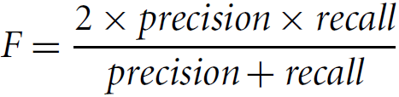
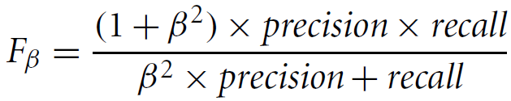
Classifier Evaluation Metrics
Precision: exactness – what % of tuples that the classifier labeled as positive are actually positive
Recall: completeness – what % of positive tuples did the classifier label as positive?
F measure (F₁ or F-score): harmonic mean of precision and recall
F_{ß}: weighted measure of precision and recall
assigns ß times as much weight to recall as to precision

Slide 61
ROC Curve

